Slide 1

CSE322
Formal Languages and Automation Theory
Lecture #0

Slide 2
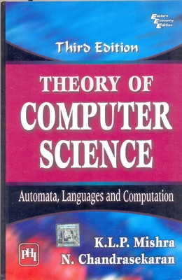
Course Details
LTP – 3 0 0 [Three lectures/week]
Text Book
  Theory of Computer Science: Automata, Languages and Computation
    Author: KLP Mishra and N. Chandrasekaran

Slide 3
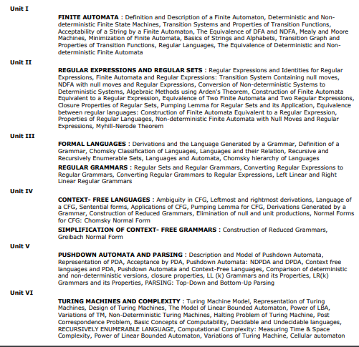
Course Contents

Slide 4
Program Outcomes (POs)
PO1:Engineering knowledge
PO2:Problem Analysis
PO3: Design and Development
PO4:Conduct Investigations
PO5:Modern Tool
PO6:The Engineer and society
PO7:Environment and sustainability
PO8:Ethics
PO9:Individual and Teamwork
PO10:Communication
PO11:Project management
PO12:Lifelong learning
PO13:Competitive skills

Slide 5
Course Outcomes
A student completing this course would be able to:
CO1 :: understand the fundamental concepts of Formal Languages and Automata
CO2 :: illustrate Finite Automata’s for different Regular Expressions and Languages
CO3 :: compare different types of Grammars and design context free grammars for formal languages
CO4 :: construct Push Down automata and Turing Machine for formal languages
CO5 :: differentiate regular, context-free and recursively enumerable languages
CO6 :: discuss key notions of computation, computability, decidability, reducibility, and complexity through problem solving

Slide 6
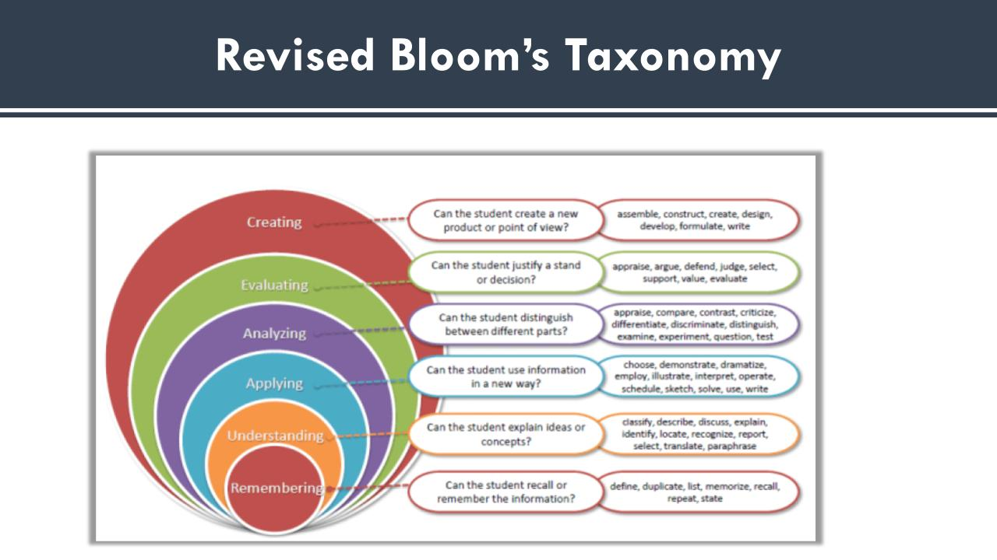

Slide 7
Course Assessment Model
>=90% -- 5 marks
>=85% and <90% -- 4 marks
>=80% and <85% -- 3 marks
>=75% and <80% -- 2 marks
Marks break up
Attendance 5
CA(Best 2out of 3) 20
MTE 25
ETE 50
Total 100
Each CA would be of 30 marks. Best 2 would be taken at the end (60 marks) which would be prorated out of 20
MTE would be of 40 marks and it would be prorated to 25 at the end
ETE would be of 70 marks and it would be prorated to 50 at the end

Slide 8
Detail of Academic Tasks
CSE322
AT1: Test1 Lecture #11 (Before MTE)
AT2: Test2 Lecture #19 (Before MTE)
AT3: Test3 Lecture #33 (After MTE)

Slide 9
Main Perspective
Main perspective for the Automata theory are:
Why we study Automata Theory?
What would we do with it?
What will be the course outcome?

Slide 10

Why Study Automata Theory?

Slide 11
Automata theory tells very important equivalence between
a language: some -- usually -- infinite set of strings
a grammar: the finite set of rules to generate that language
an automaton: the abstract processing device that can recognize that language

Slide 12
Why Study Automata Theory?
Automata theory is the study of abstract computational devices
Abstract devices are (simplified) models of real computations
Computations happen everywhere: On your laptop, on your cell phone, in nature, …
Why do we need abstract models?

Slide 13
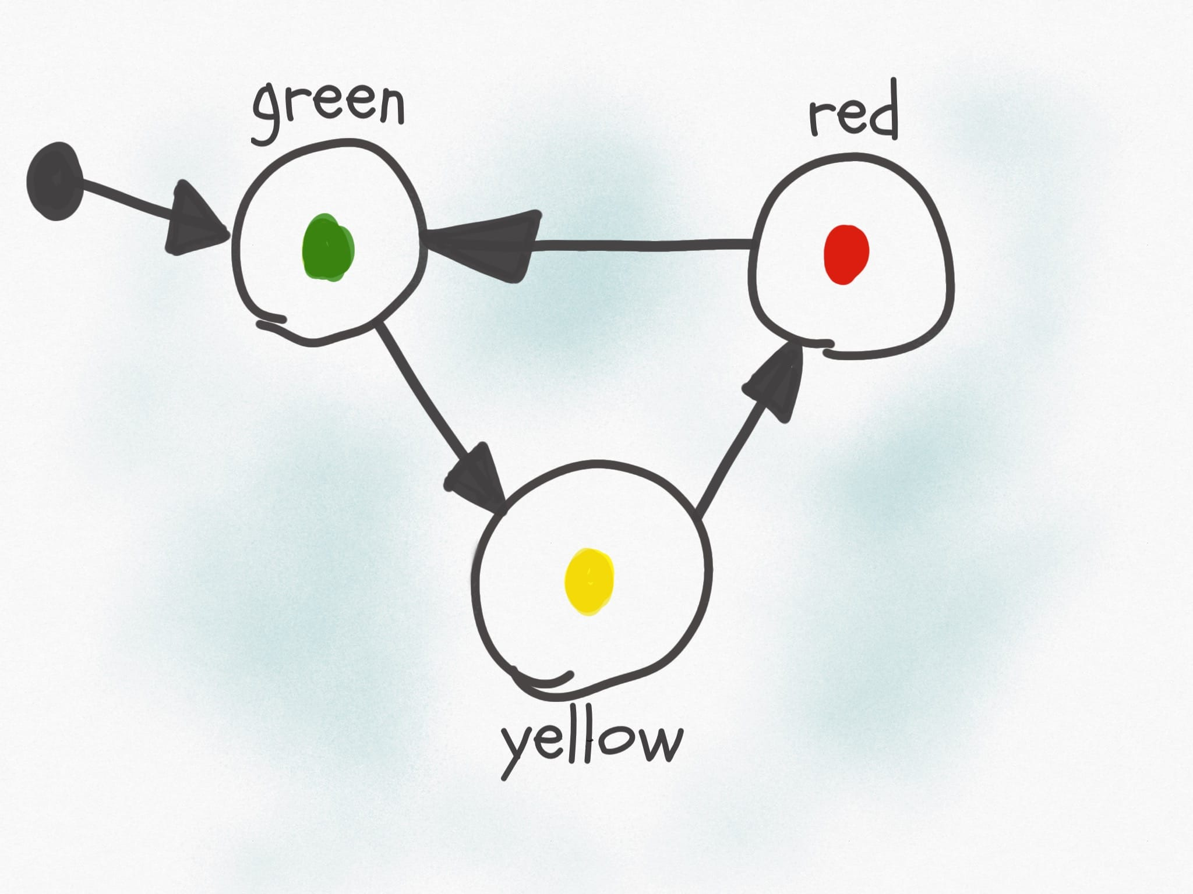
Why Study Automata Theory?

Slide 14
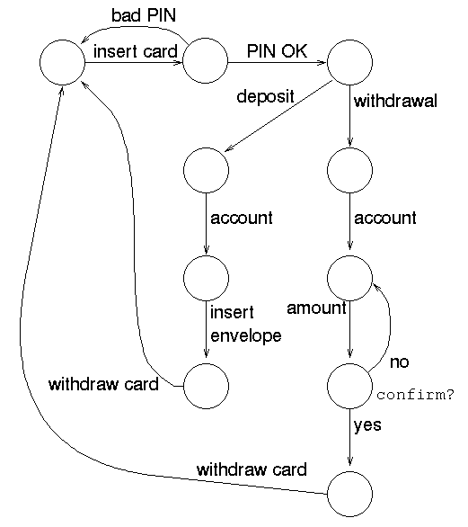
Why Study Automata Theory?

Slide 15
Why Study Automata Theory?
Such devices are difficult to reason about, because they can be designed in an infinite number of ways
By representing them as abstract computational devices, or automata, we will learn how to answer such questions

Slide 16
What would we do with it ?
There are numerous applications of Formal languages and Automata Theory like:
Text processing, Compilers and Hardware Design
Motors and Vending machines
Sensors and Transducers
Automata Simulators
And many more ….

Slide 17
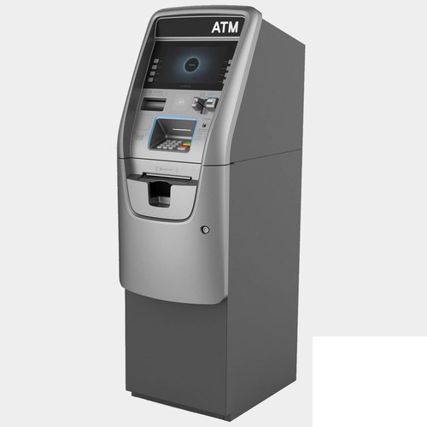
ATM MACHINE

Slide 18
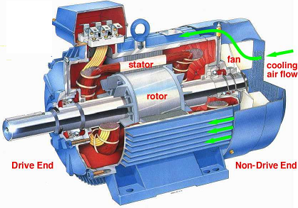
Motor

Slide 19
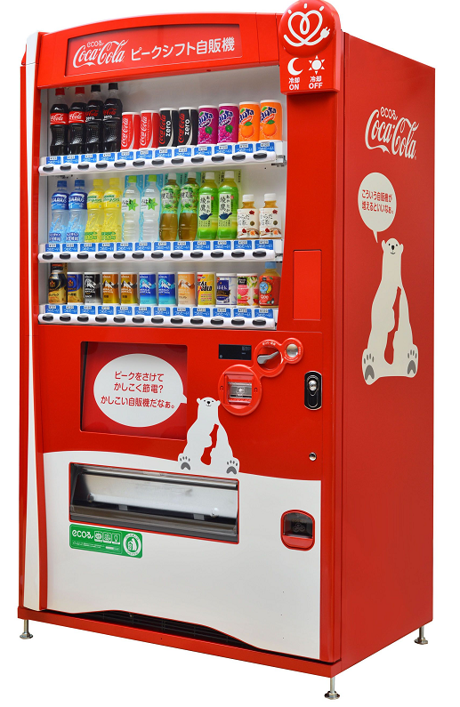
Vending machine

Slide 20
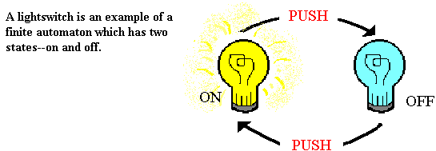
Finite Automata
UNIT 1
Notes:
UNIT 1

Slide 21
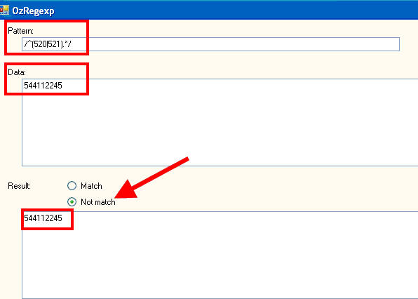
UNIT 2: Regular Expressions and Regular Sets
Notes:
UNIT 1

Slide 22
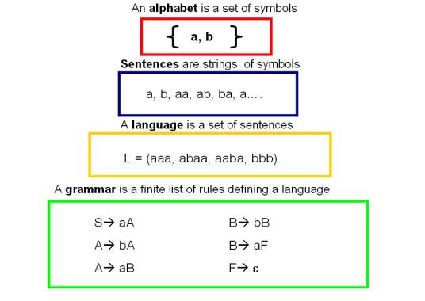
UNIT 3: Formal Languages &Regular Grammar
Notes:
UNIT 1

Slide 23
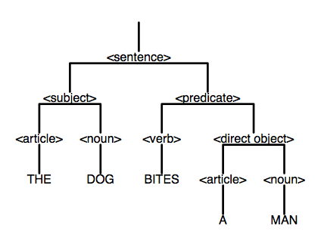
UNIT 4: Context Free languages and Simplification of context free grammar
Notes:
UNIT 1

Slide 24

UNIT 5 : Push Down Automata & Parsing
Notes:
UNIT 1

Slide 25
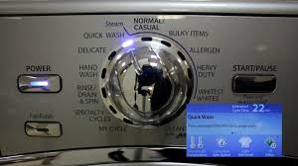
UNIT 6: Turing Machine and Complexity
Notes:
UNIT 1

Slide 26

Let’s Start: Basic Description for Finite Automata

